Slide 1



Ethics in IT
Class IX
lab 1

Slide 2

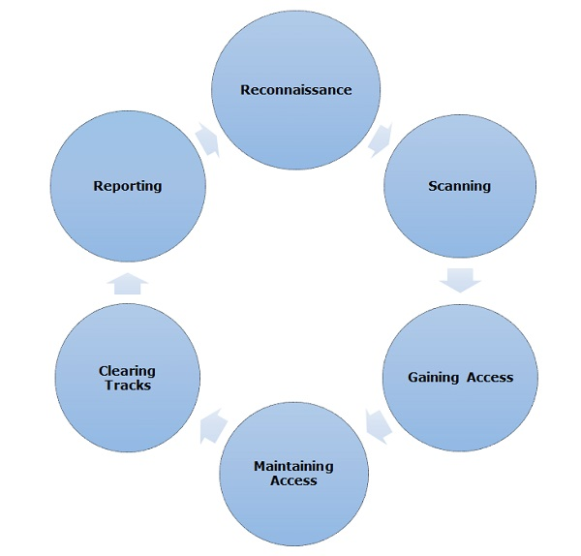
Phases of Ethical Hacking

Slide 3

Reconnaissance
attacker gathers information about a target using active or passive means

Slide 4

Scanning
In this process, the attacker begins to actively probe a target machine or network for vulnerabilities that can be exploited

Slide 5

Gaining Access
In this process, the vulnerability is located and you attempt to exploit it in order to enter into the system

Slide 6

Maintaining Access
After gaining access, the hacker installs some backdoors in order to enter into
the system

Slide 7

Clearing Tracks
it has to do with the deletion of logs of all the activities that take place during the hacking process

Slide 8



